Slide 1
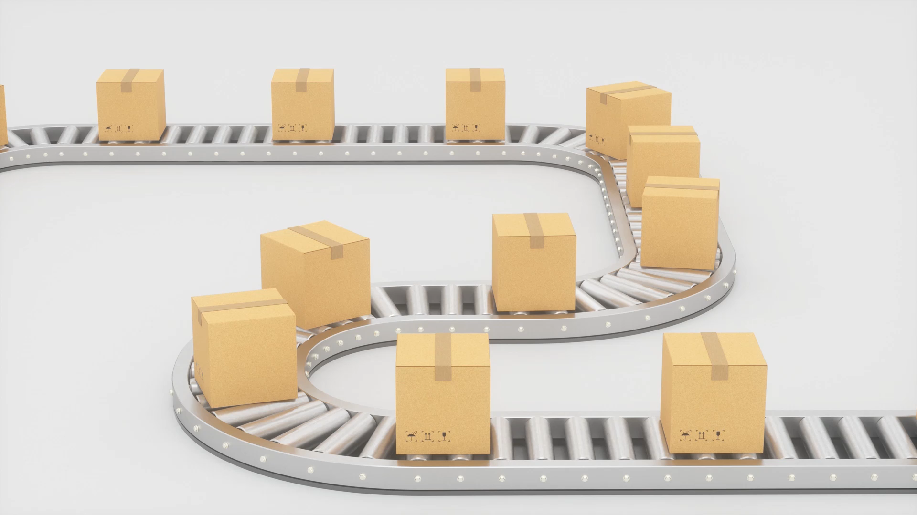
Industrial Goods
Unit 6

Slide 2
Concept
Industrial products are the goods that the companies and businesses use for the production of other products or their business operations. The government institutes, non-profit organizations, commercial businesses, and manufacturing firms usually employ industrial products. Thus, raw materials, fabricating materials and parts installation, accessory equipment's and operating supplies etc. comes under the concept of an industrial product.
An industrial product refers to goods used in the production of other goods or services, typically within an industrial or manufacturing context. These products are usually sold in large quantities and are integral to the operations of businesses and industries.

Slide 3
Definitions
“Industrial goods are destined to be sold primarily for use in producing other goods or rendering services as contrasted with goods destined to be sold primarily to the ultimate consumer”, American Marketing Association.
“Industrial goods are destined for use in the commercial production of other goods or in connection with carrying on some business or institutional activity”, Cundiff, Still and Govoni.
An industrial product is a good or service used in the production, operations, or maintenance of other goods and services in various industries. Unlike consumer products, which are sold directly to individuals for personal use, industrial products are typically sold to businesses and organizations.

Slide 4
Characteristics
Purpose: Used to produce other goods or provide services.
Market: Sold in business-to-business (B2B) markets rather than to individual consumers.
Complexity: Often involve advanced technology and require specialized knowledge.
Customization: Can be tailored to meet specific industry requirements.
Durability: Designed to withstand rigorous use and harsh environments.

Slide 5
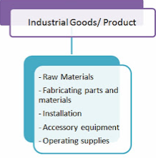
Types
Industrial products can be categorized into several types based on their usage and application within various industries. Here are the primary categories:
Raw Materials
Fabricating Materials and Parts
Installations
Accessory Equipment
Operating Supplies

Slide 6
Raw Materials
The raw material is an industrial product that businesses use for the production of other products. Natural resources like livestock, agricultural products, oceanic products, mineral water, and forest products fall under the category of raw material. The raw material usually loses its original state during the process and the final product. Raw material and parts become a part of the final product after going through various stages of processing. Natural gas, iron ore, coal, petroleum, crude, fruits, wheat, cotton, and jute are the raw material. The raw materials are also divided into two categories as (a) farm products such as millets, wheat, barley, corn, paddy, cotton, tobacco, fruits, animal products etc. and (b) natural products such as gold, silver, iron, copper, coal, petroleum, herbs, valuable stones etc. As there are many producers of agricultural/ farm product, such products are supplied in many markets.

Slide 7
The supplies of farm products come from small producers, and they use various intermediaries to sell their products. Natural product producers are usually limited in number and sell their products directly to the industries.
The manufacturing raw material comprises casting, tires, small motors, wires, cement, iron, and others. Price matters a lot in the parts and manufacturing materials. The more focus is on the service rather than advertising and branding.

Slide 8
Features
Raw materials are the part of any finished goods. The finished goods can be a quality goods only if the quality of raw materials is good. Raw materials also need to be collected from different places or regions. Features of such materials may be different. Generally, the main features of raw materials can be mentioned as follows:
Businesses or industries purchase raw materials regularly,
The life of animals, agricultural products becomes very short,
Per unit value of natural raw materials becomes low,
Only some big businesses or producers deal in natural goods and supply also remains limited.

Slide 9
Market Consideration
While selling/distributing raw materials agreement/ contract may be done between buyer and seller. Quantity, price, distribution, quality, standard etc. is determined on the basis of the contract/ agreement. This should be sincerely implemented by both sides. As far as possible, very short channel should be used for supplying such goods. The main things to be considered in marketing are as follows:
More attention should be given to the quality of raw material than to the brand/ trademark.
Shortest channel should be used for distribution of such goods,
As competition becomes tough in agricultural/ animal products, a proper strategy should be adopted for such goods,

Slide 10
No promotional activities need to be conducted in context of distribution/ supply of raw materials,
No pre or post sale services are needed,
As such goods become different in quality and nature, they should be carefully stored and transported,
Long term agreement/ contract should be done for supplying such goods of different quality and standard.

Slide 11
Fabricating Parts and Materials
Raw materials or finished goods can be used in making any type of new goods. A new product can be made using two or more types of goods. In this way, the goods which are used as part of readymade goods are called fabricating, so they are also called finished materials. After including such materials in main product, new type of product becomes ready. Such finished materials are used without changing their form to produce the third goods. Motor tires, buttons, zippers, batteries, machinery parts etc. are the examples of such goods. Per unit price of such goods becomes relatively low. The producers or business houses try to buy these goods as much in amount as they can

Slide 12
Features
The fabricating parts or materials are used without changing their quality, form and nature to prepare a third product. These parts have an important role in new goods. They give completeness to the newly made goods. They have various quality and features. They can be mentioned as follows;
The fabricated goods or materials remain as important part of the ready-made products.
The life of such goods depends on the parts and materials used in them.
Per unit value of such products becomes relatively low.
These types of parts or materials should be purchased in large amount.
Industrialists do not buy fabricating parts or materials every time.

Slide 13
Market Consideration
The entrepreneurs decide to buy such goods on the basis of services and warranty of the sellers. If consideration about important thing is not given, marketing can be affected. As a result, other suppliers control the market and reap benefits. So, the following things should be considered while marketing such goods/ materials.
Duration of contract or agreement between buyer and supplier of machinery parts and materials should be long.
Supply or distribution channel of such goods should be short and direct as far as possible.

Slide 14
Post sale services (service after sale) should be compulsorily provided,
Promotional activities for such materials and machinery parts should be conducted.
Branding of such goods is not given importance.

Slide 15
Installation
Big industrial capital equipment and instruments are called big machines. Such capital equipment becomes costly and long lasting. In the lack of these important machineries, raw materials cannot be changed into finished goods. Industrialists get encouragement to conduct business with the help of such equipment. These types of goods signify the scope, nature and efficiency of any business organization. Generator, office building, offset machine, computer, lift, billing machines etc. are the examples of machines. As these machines and apparatus need huge investment, a rational decision should be taken to buy, collect and install them. Such decision is taken by high level management.

Slide 16
Feature
Big machines are the capital equipment of business organization. Collection, purchase or installation need to invest much amount of capital. Specialists are needed to install and operate some machines/ equipment. Such equipment and apparatuses may have many features. Among them the main are as follows:
Comparatively, price of big machines and equipment becomes high.
As the price of such machines and equipment is high, they are not bought every time.
As such equipment and machines have quality and are costly, they last long.
Brand of such machines/ equipment and business organization plays important role.

Slide 17
Market Consideration
Entrepreneurs and industrialists make decisions to installation of machineries/ equipment considering their brand. So, such equipment intermediaries are not needed in buying them. As such equipment and machineries are bought through contract/ agreement, the term/ duration of the agreement should be provided for such equipment. Special suggestions and advice should be taken from specialists of such machineries. While marketing such big machineries, special considerations should be taken as follows:

Slide 18
Market Consideration
Accessory equipment and apparatus are the only helping means in the process of production. Some business organizations may use direct channel to sell them while some may use intermediaries. An efficient businessman wished to sell products by standardizing market price, quality of products, services etc. He may select supply channel considering demands received from different parts and places. While supplying such accessory equipment's, mainly the following things should be considered:

Slide 19
Although life of accessory equipment becomes very short compared to big machines, they should be sold through intermediaries,
Trademark/ brand of such equipment should be given more importance,
Promotional activities should be conducted for such equipment,
Post sale/ service after sale should be provided if buyers needed,
Agreement/ contract may be done to supply such equipment and the duration of contract should be of average type

Slide 20
Operating Supplies
The operating supplies help to conduct business activities continuously. The things which help to make production easy and regular are called operating supplies. But such goods can be the part of products. Operational supplies in the context of industrial goods refer to the consumable materials and items that are necessary for the day-to-day operation and maintenance of industrial equipment and facilities. These supplies are essential for ensuring that production processes run smoothly and efficiently. Cleaning supplies, adhesive and sealants, lubricants and oil, marking and labeling supplies, electrical supplies, office supplies, packaging materials, safety gears etc. are the examples of the operating supplies. These operational supplies are typically consumed on a regular basis and are crucial for the upkeep and efficient functioning of industrial operations.

Slide 21
Features
Operating goods cannot directly affect products; however, they provide great help in the process of production. Such indirect support becomes very important in businesses. Operating supplies have different features, the main are mentioned as follows:
The operating supplies cannot be direct part of finished products,
Price value of such goods becomes very low,
Such goods have relatively short life,
No much effort nor time is needed to buy such goods,
As price of such goods has low price, they can be bought at anytime by taking prompt decision.

Slide 22
Market Consideration
The operating goods are not supplied by the producers themselves. They make arrangement to supply/ sell through intermediaries. Some goods need branding and more advertisements and some need little. Term of contract for supplying such goods becomes short. The following things should be considered while marketing the operating supplies.
Intermediaries should be used to supply operating goods.
The duration of the contract for supplying such goods should be short.
Post sale/ after sale service is rarely provided for such goods.
Promotional activities are not important for such goods.
Importance is not given to the brand/ trademark of such goods.

Slide 23

Thank you

